Slide 1
Kernel module programming and debugging
Advanced Operating Systems

Slide 2
Kernel Modules
The provision of kernel modules allows code to be introduced into a running kernel.
This requires the kernel to be built with this capability, it also requires the commands
  Insmod and rmmod (plus lsmod, depmod and modprobe)
Modules can be loaded on demand automatically.

Slide 3
Module programming
The 2.6 kernel has changed the way module programming is handled.
  We will look at this later on – for the moment we will deal with 2.4
Modules under 2.4 are just ordinary unlinked object files (cc –o)
  Although they must link with the kernel and can bring it down, so they are rather special.

Slide 4
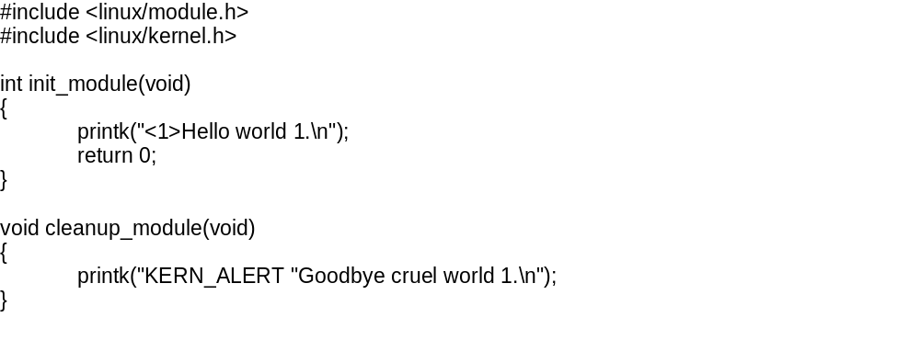
Module programs
Requires header files
  These will include others
Needs an init_module and cleanup_module function
The return value is important
  Only return 0.
Use of printk

Slide 5
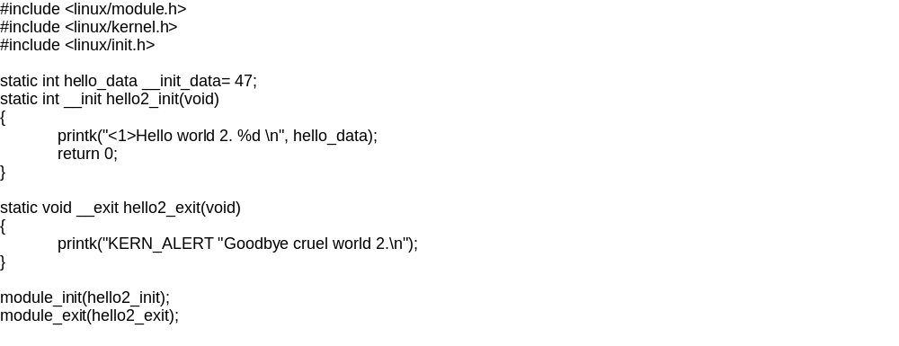
Using macros
Use of init & exit macros
Use of __init and __initdata

Slide 6
Module Makefile
WARN := −W −Wall −Wstrict−prototypes −Wmissing−prototypes
INCLUDE := −isystem /lib/modules/`uname −r`/build/include
CFLAGS := −O2 −DMODULE −D__KERNEL__ ${WARN} ${INCLUDE}
CC := gcc−3.0
OBJS := ${patsubst %.c, %.o, ${wildcard *.c}}
all: ${OBJS}
.PHONY: clean
clean:
rm −rf *.o

Slide 7
Kernel debugging
Sources:
  Love 2e: Chapter 18 "Debugging" (2.6)
  Corbet, Rubini, Kroah-Hartman 3e: Chapter 4 "Debugging Techniques" (2.6)
Debugging is hard
  Kernel debugging is harder!
  Still, many similarities to other large-scale projects
Need a reproducible bug
  Intermittent or timing-related bugs very difficult

Slide 8
Types of Kernel Bugs
Incorrect behaviors
Corrupt data
Synchronization errors, races, timing errors
Performance bugs

Slide 9
Debugging Techniques
printk()
Oops
CONFIG_DEBUG_KERNEL
SysRq keys
(Unofficial) kernel debuggers [Not ARM]
  gdb, kdb, kgdb, nlkd
/proc
strace
User Mode Linux (UML)
Linux Trace Toolkit (LTT)
Dynamic Probes (DProbes) [Intel]

Slide 10
printk()
Very robust! Callable almost anywhere…
Except very early in boot sequence
early_printk()
Circular log buffer
  klogd (user space) reads /proc/kmsg
  sends (via syslogd) to /var/log/messages
  read with dmesg
Log-levels (message priorities) 0 (high) .. 7 (low)
  /proc/sys/kernel/printk (threshold)
  KERN_EMERG, _ALERT, _CRIT, _ERR, _WARNING, _NOTICE, _INFO, _DEBUG

Slide 11
Oops
Kernel exception handler
  Kills offending process
  Prints registers, stack trace with symbolic info
Some exceptions non-recoverable (panic())
  Prints message on console, halts kernel
  Oops in interrupt handler, idle (0) or init (1)
Oops generated by macros:
  BUG(), BUG_ON(condition)

Slide 12
ksymoops
Oops must be "decoded"
  Associate symbolic names with addresses
Address info lives in System.map
  Kernel symbol table generated during compile
  Module symbols included as well
ksymoops – user-mode program (file access)
kallsyms
  2.6 technique
  Reads System.map into kernel memory at init

Slide 13
CONFIG_DEBUG_KERNEL
Many kernel subsystems have extensive debugging that can be compiled in
Subsystem specific compile-time debugging
  _SLAB, _PAGEALLOC, _SPINLOCK, _INIT, _STACKOVERFLOW, _ACPI, _DRIVER, _PROFILING
Info goes to console and /proc

Slide 14
Magic SysRq Keys
Special console key sequences recognized by kernel
  Useful for "system hangs"
  Must be compiled in CONFIG_MAGIC_SYSRQ
Alt-SysRq-<key>
  h: help, b: reboot, s: sync, u: unmount all, etc.
Toggle on/off:
  /proc/sys/kernel/sysrq
Possible to activate remotely by writing char to /proc
  /proc/sysrq-trigger

Slide 15
(Unofficial) Kernel Debuggers
No official kernel debugger!
  Linus believes developers should deeply understand code and not rely on the "crutch" of an interactive debugger
  Many still use debuggers from time to time (including Linus)
gdb (from user-mode)
  gdb <kernel image> /proc/kcore
  Compile with CONFIG_DEBUG_INFO for symbolic info
  Problem: caches symbol values *sigh*
kdb (part of kernel) [Intel only]
  Kernel halted when kdb runs
kgdb (debug live kernel remotely via serial port)
  Two separate patches; in flux; originally from SGI
  Available for many architectures (but not ARM?)
nlkd (new debugger from Novell)

Slide 16
/proc
Export kernel info via /proc
Write your own /proc files
  Can be read-only or read-write
  Provide a special read_proc() function
  Register with create_proc_read_entry()
  Details in CRK
Cleaner interface (seq_file) in 2.6
  Better for files with lots of data
  Iterator style (get_next)

Slide 17
strace
View entry/exit of user-mode processes via system call interface
Good for debugging new system calls

Slide 18
User Mode Linux (UML)
Linux kernel emulation that runs as a user-mode process!
Implemented as architecture port (arch/um)
Easy to debug with gdb
Slow
Not useful for debugging hardware interactions (emulated)

Slide 19
Linux Trace Toolkit
Generic event trace framework for kernel
Includes timing information
Slows things down but provides relative timing info
Kernel tracing infrastructure + user-mode applications for viewing (graphs, etc.)
Many supported architectures including ARM

Slide 20
Dynamic Probes (DProbes)
Contributed by IBM for IA32
Allows placement of "probes" anywhere in kernel
Probes are code written in a special interpreted language
Executed when flow-of-control reaches probe
New probes can be inserted without kernel rebuild or reboot

Slide 21
Some Debugging Tricks
Code conditional on UID
  if (current->uid == 7777) { … }
Rate limiting printk()
  Record print time
  Only print again if interval elapsed

